Slide 1
Building the business migration case with Windows Server and SQL Server
Presenter Name

Slide 2
Abstract and learning objectives
In this whiteboard design session, you will look at how to design for converting/extending an existing IaaS deployment for resiliency. Throughout the whiteboard design session, you will look at the various configuration options and services to help build resilient architectures.
At the end of the workshop, you will be better able to design and use resiliency concepts including high availability with Availability Zones, disaster recovery for virtual machines to another region using Azure Site Recovery, and SQL Server high availability and disaster recovery using AlwaysOn Availability Groups. You will also learn how to assess the availability SLA, RPO, and RTO of your design, and how to use Azure Backup to protect and secure your SQL data and VMs against corruption and loss.
You will also discuss how to achieve a similar level of resiliency for a PaaS-based implementation of the same application, based on Azure App Service and Azure SQL Database. Finally, you will consider the costs associated with both approaches.

Slide 3
Step 1: Review the customer case study
Outcome
Analyze your customer needs.
Timeframe
15 minutes

Slide 4
Customer situation
Tailspin Toys is a global manufacturer of children’s toys headquartered in Milwaukee, WI
They are currently hosting mission critical workloads in an on-premises datacenter
Kaylee Frye, CTO of Tailspin, has already had their Technical Architects create an assessment of their current environment, of which they’ve already identified apps and workloads to migrate first
Their workloads are primarily Windows Server and SQL Server VMs
Their on-premises environment consists of over 250 servers and VMs and are hosted using Hyper-V

Slide 5
Customer situation (continued)
They’ve identified some initial workloads they’d like to migrate first including Window Server VMs hosting .NET Framework applications and SQL Server databases.
They’ve also identifies some additional workloads that will remain on-premises but would like to ease their management burden.

Slide 6
Customer needs
Migrate existing workloads to Azure as efficiently as possible.
Lower the management burden with a consolidated view to manage VMs and Servers across Azure and on-premises
Security is extremely important when integrating the on-premises network and workloads with Microsoft Azure.
With Windows Server 2012 extended support ending October 10, 2023, the new Azure VMs will need to be deployed using a newer version of Windows Server.

Slide 7
Customer objections #1
It appears there are multiple options for hosting SQL databases in Azure. What's the best option to choose, and how do you know it'll be compatible?
What kind of downtime will be incurred when migrating the Windows Server and SQL Server workloads to Azure?
Will we be able to roll back to the on-premises VMs if the migration fails?

Slide 8
Customer objections #2
We know there are workloads that will not be migrated to Azure. What's the best way to handle managing all our VMs across on-premises and Azure?
Tailspin has negotiated an Enterprise Agreement (EA) with Microsoft for their Azure consumption. Any cost estimates need to reflect their EA discount.
Securing and monitoring our on-premises workloads is extremely important. What options does Azure offer to extend this into the cloud?
Would there be further savings from the use of PaaS services?

Slide 9
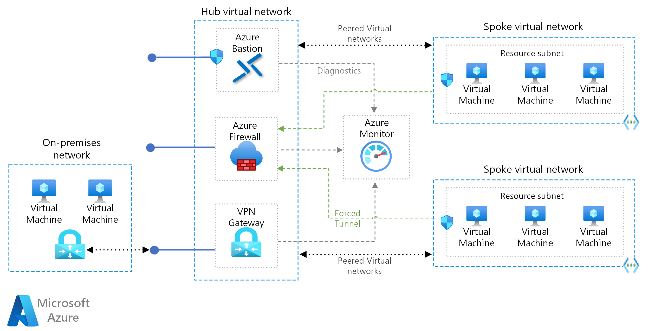
Common scenarios
Notes:
The hub virtual network acts as a central point of connectivity to many spoke virtual networks. The hub can also be used as the connectivity point to your on-premises networks. The spoke virtual networks peer with the hub and can be used to isolate workloads.
https://docs.microsoft.com/azure/architecture/reference-architectures/hybrid-networking/hub-spoke

Slide 10
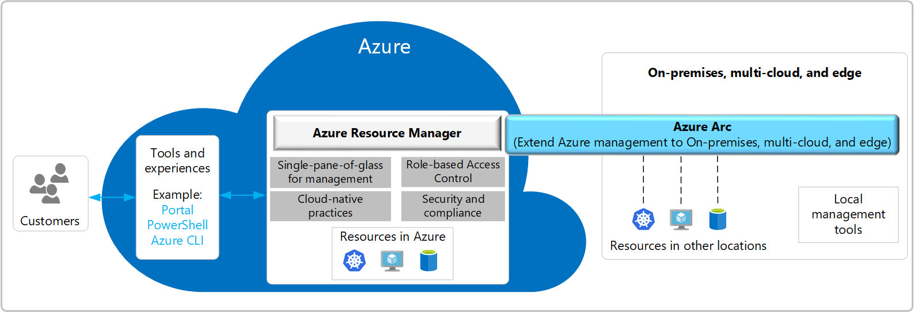
Common scenarios
Notes:
Azure Arc simplifies governance and management by delivering a consistent multi-cloud and on-premises management platform. Azure Arc provides a centralized, unified way to manage your entire environment together by projecting your existing on-premises resources into Azure Resource Manager.
https://docs.microsoft.com/azure/azure-arc/overview

Slide 11
Step 2: Design the solution
Outcome
Design a solution and prepare to present the solution to the target customer audience in a 15-minute chalk-talk format.
Timeframe
1-2 hours
Business needs | Respond to questions outlined in your student guide and be prepared to present your solution to others.
Design | Design a solution for as many of the requirements in your student guide as time allows.
Pricing | Provide an estimate of the costs associated with each aspect of your solution, following the questions in your student guide.
Prepare | Identify any customer needs that are not addressed with the proposed solution. Identify the benefits of your solution. Determine how you will respond to the customer’s objections. Prepare for a 15-minute presentation to the customer.

Slide 12
Step 3: Present the solution
Outcome
Present a solution to the target customer in a 15-minute chalk-talk format.
Timeframe
30 minutes (15 minutes for each team to present and receive feedback)
Directions
Pair with another team.
One group is the Microsoft team and the other is the customer.
The Microsoft team presents their proposed solution to the customer.
The customer asks one of the objections from the list of objections in the case study.
The Microsoft team responds to the objection.
The customer team gives feedback to the Microsoft team.
Switch roles and repeat Steps 2-6.

Slide 13
Wrap-up
Outcome
Review the preferred solution for the case study.
Timeframe
15 minutes

Slide 14
Building the business migration case with Windows Server and SQL Server
Whiteboard Design Session – Preferred Solution

Slide 15
Preferred target audience
Kaylee Frye, CTO
Technical Architects

Slide 16
Preferred Solution-#1
How will you migrate the on-premises workloads to Azure?
Since it is recommended to upgrade the version of Windows Server from 2012 to 2022, it will be necessary to create new servers. In this case, Azure Migrate won't be able to be used to lift and shift the on-premises VMs into Azure. For this reason, the Azure VMs will be created new and the application workloads will be installed and configured on the new VMs.

Slide 17
Preferred Solution-#2
How will you migrate the SQL Server workloads to Azure?
For the SQL Server databases, Tailspin should use the Microsoft Data Migration Assistant (DMA) to assess database migration readiness. Using DMA to examine the existing on-premises databases will report any compatibility issues ahead of attempting the migration. Typically, SQL Server databases can be migrated to Azure SQL Database or Azure SQL Database Managed Instances. Also, Azure SQL Managed Instances offers greater compatibility with the on-premises SQL Server. SQL Server in Azure VMs could be used, however this will negate the advantages of using a managed service that eliminates the requirement for ongoing VM maintenance.

Slide 18
Preferred Solution-#3
Which workloads should remain on-premises and which should be considered to be migrated at a later time?
Among the workloads that have been identified for advice on migration to Azure, the Windows Domain Controllers are recommended to keep in the on-premises data-center at this time.
It is recommended to migrate the on-premises Network File Shares and Ubuntu VMs to Azure in a later phase of their Azure adoption. A phased approach to the migration process will enable each workload to be methodically migrated to Azure while limiting the risk of downtime across the organization.

Slide 19
Preferred Solution-#4
How will they reduce the burden of managing both on-premises and Azure workloads?
After some of the VMs are migrated to Azure, and others are still on-premises, it may be more burdensome to manage all their workloads in one place. For this, the use of Azure Arc is recommended. Azure Arc will enable Tailspin to centrally manage all their VMs in Azure and on-premises. Azure Arc supports managing both Windows and Linux servers and VMs.
The on-premises Windows and Linux VMs can be Azure Arc-enabled by installing the Azure Connected Machine agent. The agent brings with it the ability to manage the VMs with Azure Arc, as well as all the great features the service has to offer.

Slide 20
Preferred Solution-Pricing #1
Since Tailspin Toys and their current on-premises data center is in Milwaukee, WI. The nearest Azure Region to use will be North Central US.

Slide 21
Preferred Solution-Pricing #2
Component | Region | Details / Assumptions | Est. Monthly Cost (USD)
Web VMs (Web App Front-end) | North Central US | 2x D4s v5 VMs (4 vCores, 16 GiB RAM) & Windows Server 2022 | $140.00 each
Web VMs (REST API Back-end) | North Central US | 2x D8s v5 VMs (8 vCores, 32 GiB RAM) & Windows Server 2022 | $280.00 each
Azure SQL Managed Instance (App SQL Databases) | North Central US | 16 vCores Premium-series General Purpose (7 GB RAM/vCore) & 2 TB storage | $1,265.92

Slide 22
Preferred objections handling #1
Objection
It appears there are multiple options for hosting SQL databases in Azure. What's the best option to choose, and how do you know it'll be compatible?
Potential answer
Microsoft Azure does provide multiple options for hosting SQL databases. Azure SQL refers to a family of managed, secure, and intelligent products that use the SQL Server database engine in the Azure cloud. There is some overlap between the different options available, with each targeting different use cases, scenarios and business motivations.
For Tailspin Toys, it is recommended to use Azure SQL Managed Instances (SQL MI) for migrating the SQL Server databases to Azure. SQL MI provides near 100% compatibility with on-premises SQL Server database instances and includes features to best handle the common isolation and security concerns required by Tailspins organization.

Slide 23
Preferred objections handling #2
Objection
What kind of downtime will be incurred when migrating the Windows Server and SQL Server workloads to Azure?
Potential answer
All application tiers and databases will be deployed to the Azure VMs in parallel to the on-premises VMs. This will enable minimal downtime when the application load is redirected to the new VMs.
To ensure data consistency during the migration, there will be a short window of downtime required at the database level when the cutover to the new servers is performed. Data migration using DMS supports online migration, allowing the applications to be kept online while data is synchronized.

Slide 24
Preferred objections handling #3
Objection
Will we be able to rollback to the on-premises VMs if the migration fails?
Potential answer
The migration process will be designed to create new application deployments within their CI/CD pipelines to release to the new Windows Server 2022 VMs in Azure in parallel to the existing on-premises VMs. This will allow traffic to be cut over to the new VMs when ready.
In the event of an unexpected issue during migration, the existing on-premises VMs, application deployments, and databases will remain in place as a fallback. If there is an issue detected during the cutover process, the on-premises servers will be able to immediately pick up where they left off.

Slide 25
Preferred objections handling #4
Objection
We know there are workloads that will not be migrated to Azure. What's the best way to handle managing all our VMs across on-premises and Azure?.
Potential answer
Azure Arc provides the ability to use a single pane of glass to manage all your VMs and servers across on-premises and Azure.
Azure Arc-enabled servers lets you manage Windows and Linux physical servers and virtual machines hosted outside of Azure, such as on-premises VMs. This management experience is designed to be consistent with how you manage native Azure virtual machines, using standard Azure constructs such as Azure Policy and applying tags.

Slide 26
Preferred objections handling #5
Objection
Tailspin has negotiated an Enterprise Agreement (EA) with Microsoft for their Azure consumption. Any cost estimates need to reflect their EA discount.
Potential answer
We absolutely want to take advantage of these savings for them! The cost estimates from the Azure Pricing Calculator can be tailored to reflect their EA discount.

Slide 27
Preferred objections handling #6
Objection
Securing and monitoring our on-premises workloads is extremely important. What options does Azure offer to extend this into the cloud?
Potential answer
Microsoft Defender for Cloud is a solution for cloud security posture management (CSPM) and cloud workload protection (CWP) that finds weak spots across your cloud configuration, helps strengthen the overall security posture of your environment, and can protect workloads across multicloud and hybrid environments from evolving threats.
Azure Monitor collects monitoring telemetry from a variety of on-premises and Azure sources. Management tools, such as those in Azure Security Center and Azure Automation, also push log data to Azure Monitor. The service aggregates and stores this telemetry in a log data store that’s optimized for cost and performance. Analyze data, set up alerts, get end-to-end views of your applications, and use machine learning–driven insights to quickly identify and resolve problems.

Slide 28
Preferred objections handling #7
Objection
Would there be further savings from the use of PaaS services?
Potential answer
Further evaluation of the front-end and back-end .NET Framework applications will be necessary to determine the requirements for hosting these applications using Azure App Service. Azure App Service Web Apps provide a PaaS hosting option for applications that further reduces the management burden over IaaS VMs, and does support hosting applications build with .NET Framework, and .NET Core, among other development languages.
Azure Kubernetes Service (AKS) is another potential option for hosting applications. For Tailspin Toys, this may not be the best option as it would require further redesign and architecture of the applications to host in AKS. If Azure App Service doesn't meet the requirements of Tailspin Toys applications, then AKS may offer an alternative that fits better.

Slide 29
Customer quote
“We recognized the need and benefits to migrating our aging infrastructure to Azure. I know this migration is going to help us increase reliability while lowering operation and maintenance costs. I'm really looking forward to the shiny new capabilities we are now able to take advantage of, including the ability to manage our on-premises and Azure VMs using Azure Arc.”
— Kaylee Frye, CTO, Tailspin Toys

